Slide 2
Why Riococo PCM?
Over 15 Years experience in Commercial Hydroponic Greenhouse, as a provider of custom mixes for Flowers, Vegetables, Berries, and now medical cannabis.
Clients in over 48 countries and Netafilm as exclusive projects in 115 countries.
Over 70% of the North American large scale greenhouse use Riococo exclusively. (Village Farms, Windset Farms, Red Sun Farms, Houwling’s)
100% owned factories and 243 raw material production plants in Sri Lanka
OMRI certification, ONLY Coir substrate factory certified with ISO 9001:2015 and 14001:2015 in Sri Lanka.

Slide 3
Why Riococo PCM?
Riococo PCM is Five Times Washed, with lowest EC and Na.
Riococo PCM is Sterilized without using chemicals leaving natural positive micro - beneficial intact. (Trichoderma and Mycorrhiza)
Special Blend increases aeration between 28-33%.
Free of Eco-bacteria and heavy metal
What does all this mean?
Lower humidity, and natural positive micro - beneficial at the roots reduces risk of root and bud rot.
Stronger, Healthier roots yields happier, healthier and high yielding crops.

Slide 4
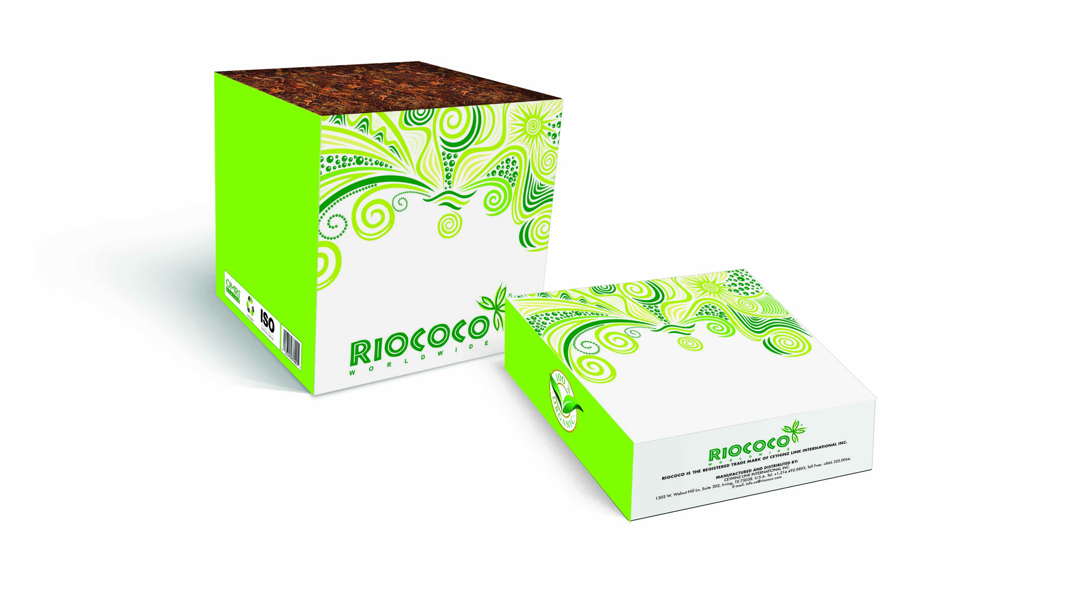
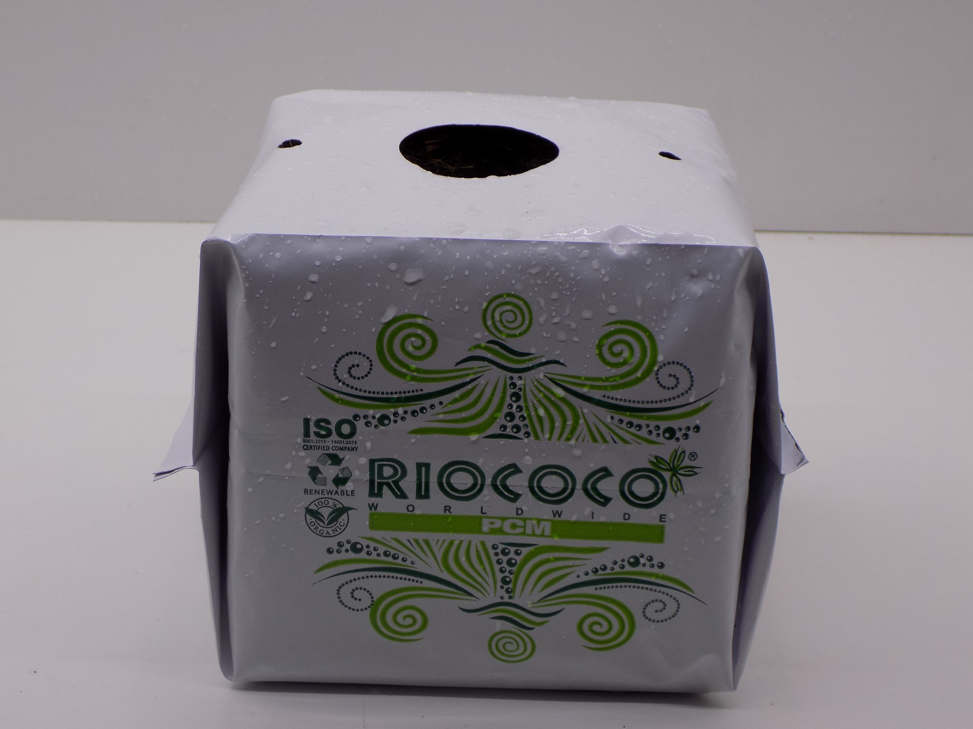
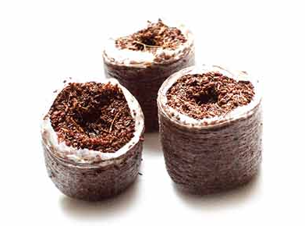
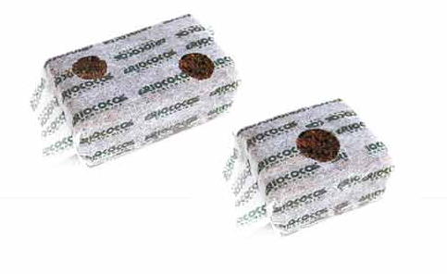
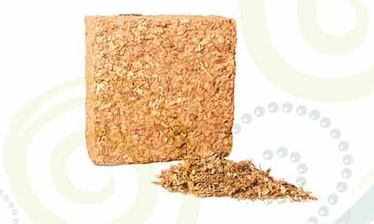
Riococo PCM Product Line
Propagation:
CBOPs starter Plugs
Starter Blocks
Growth Stage:
4.5 Kg/10 Lb PCM Block
Open Top Bags (OTBs)
Close Top Bags (CTBs)
Grow Bags

Slide 5
Riococo PCM CBOPs
Propagation:
CBOPs
25mm, 32mm, 38mm, 42mm diameters available

Slide 6
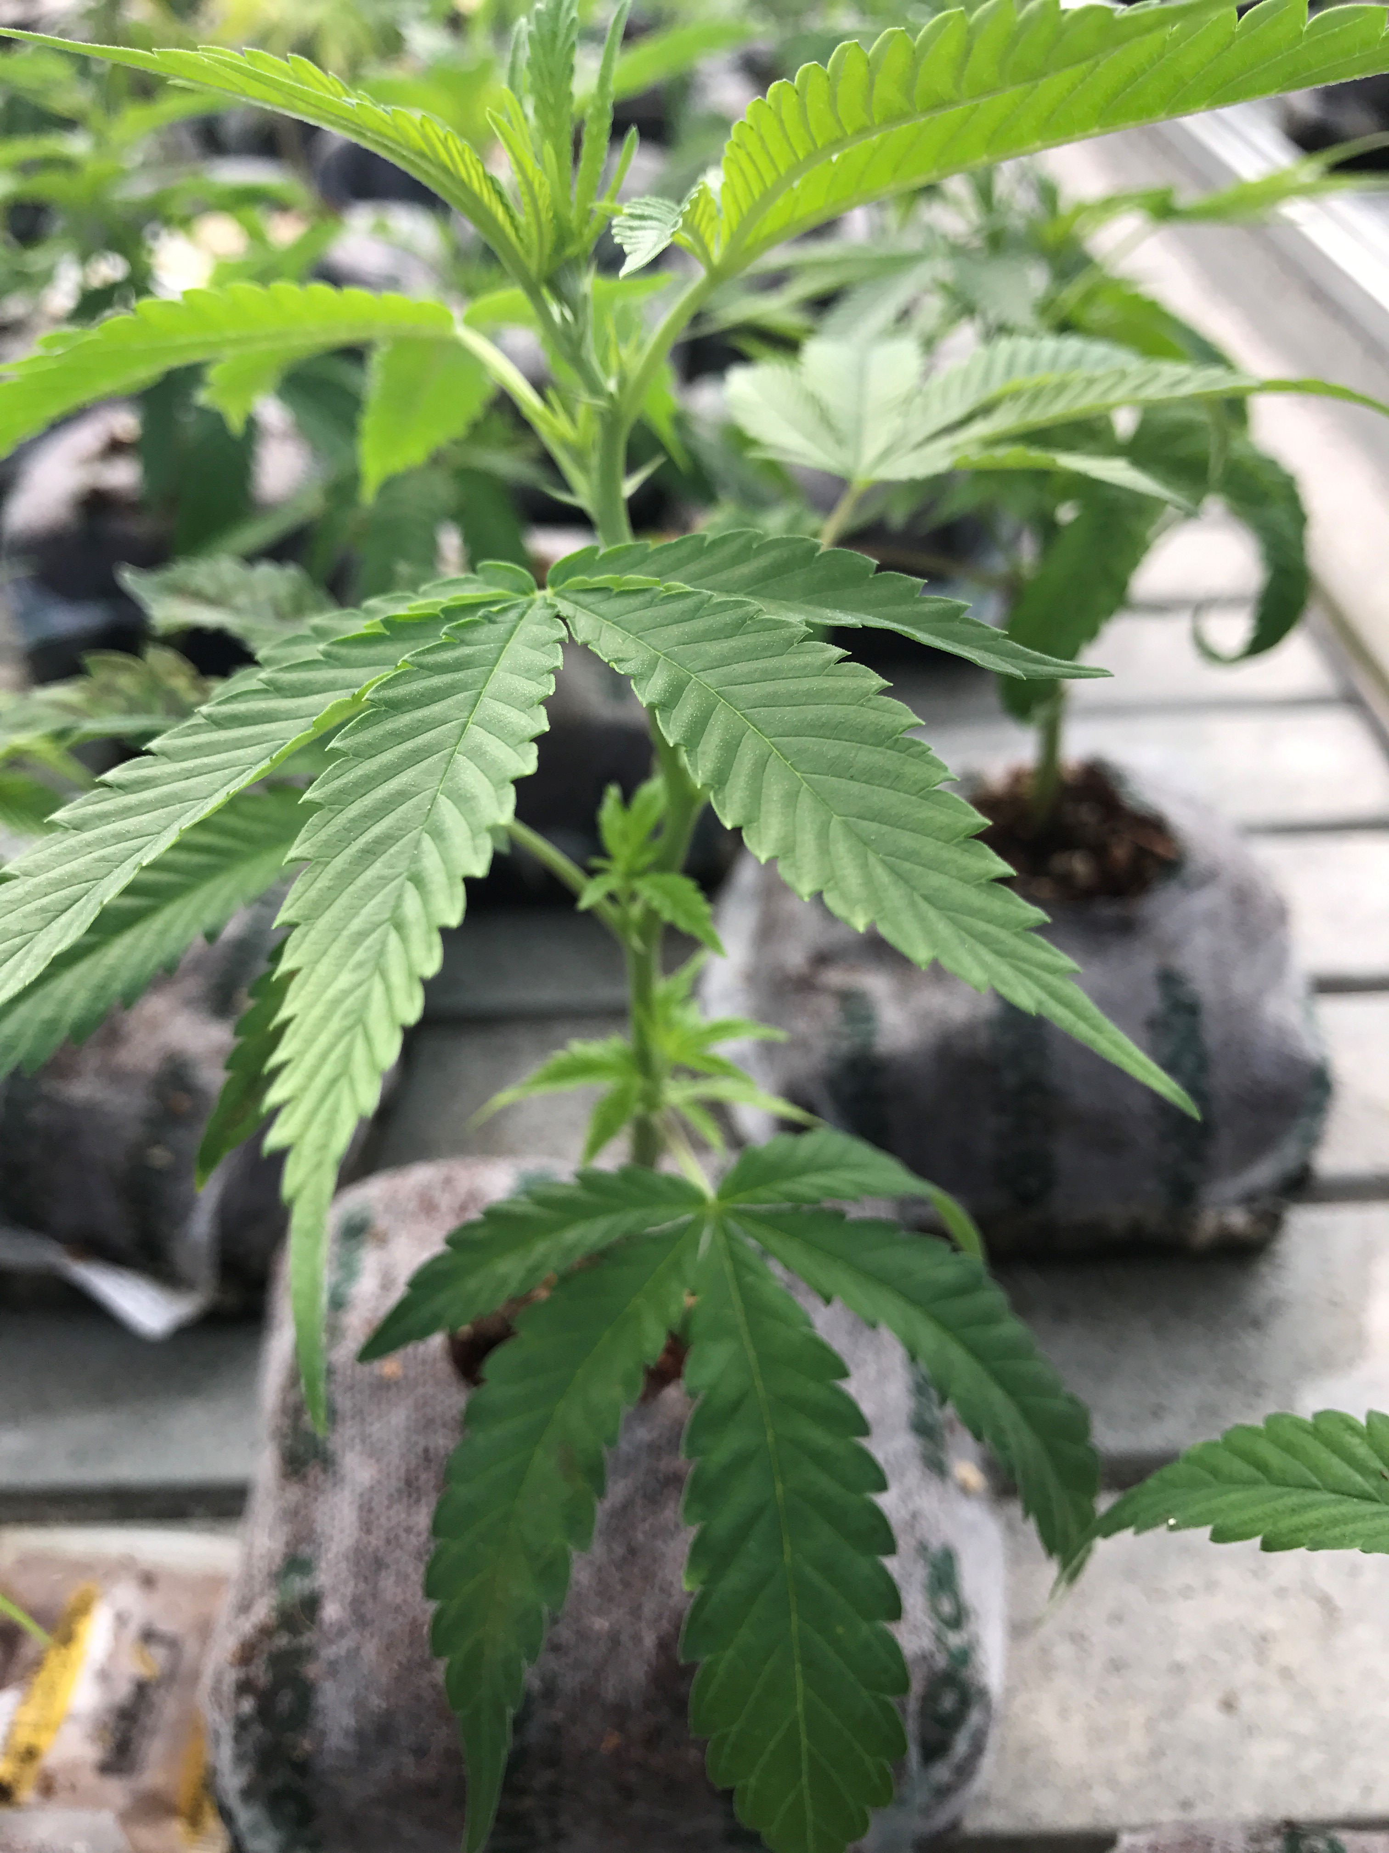
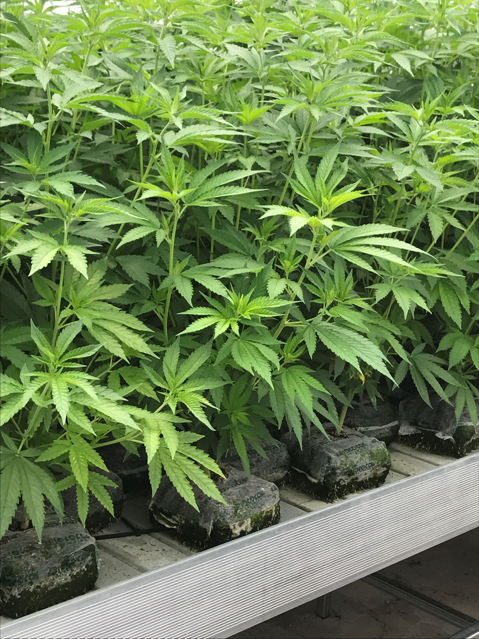
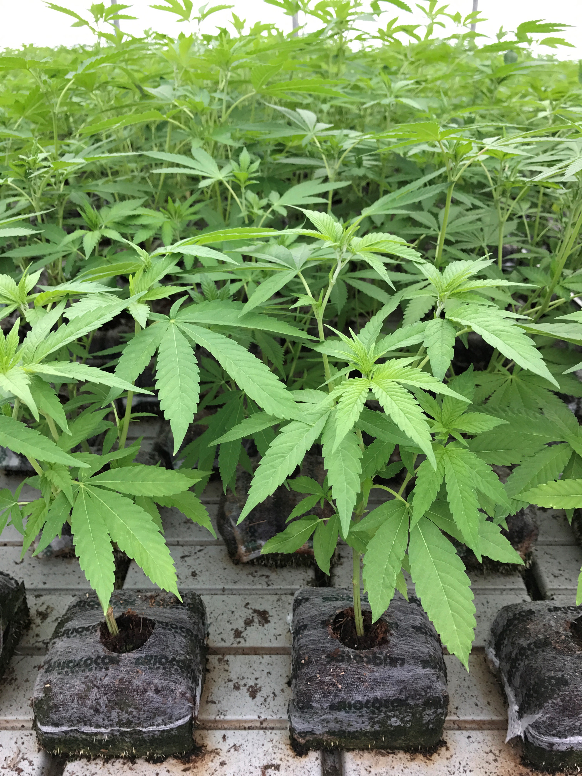
Riococo PCM Starter Block
Propagation:
Starter Blocks
7.5 x 7.5cm and 10x10cm available.

Slide 7
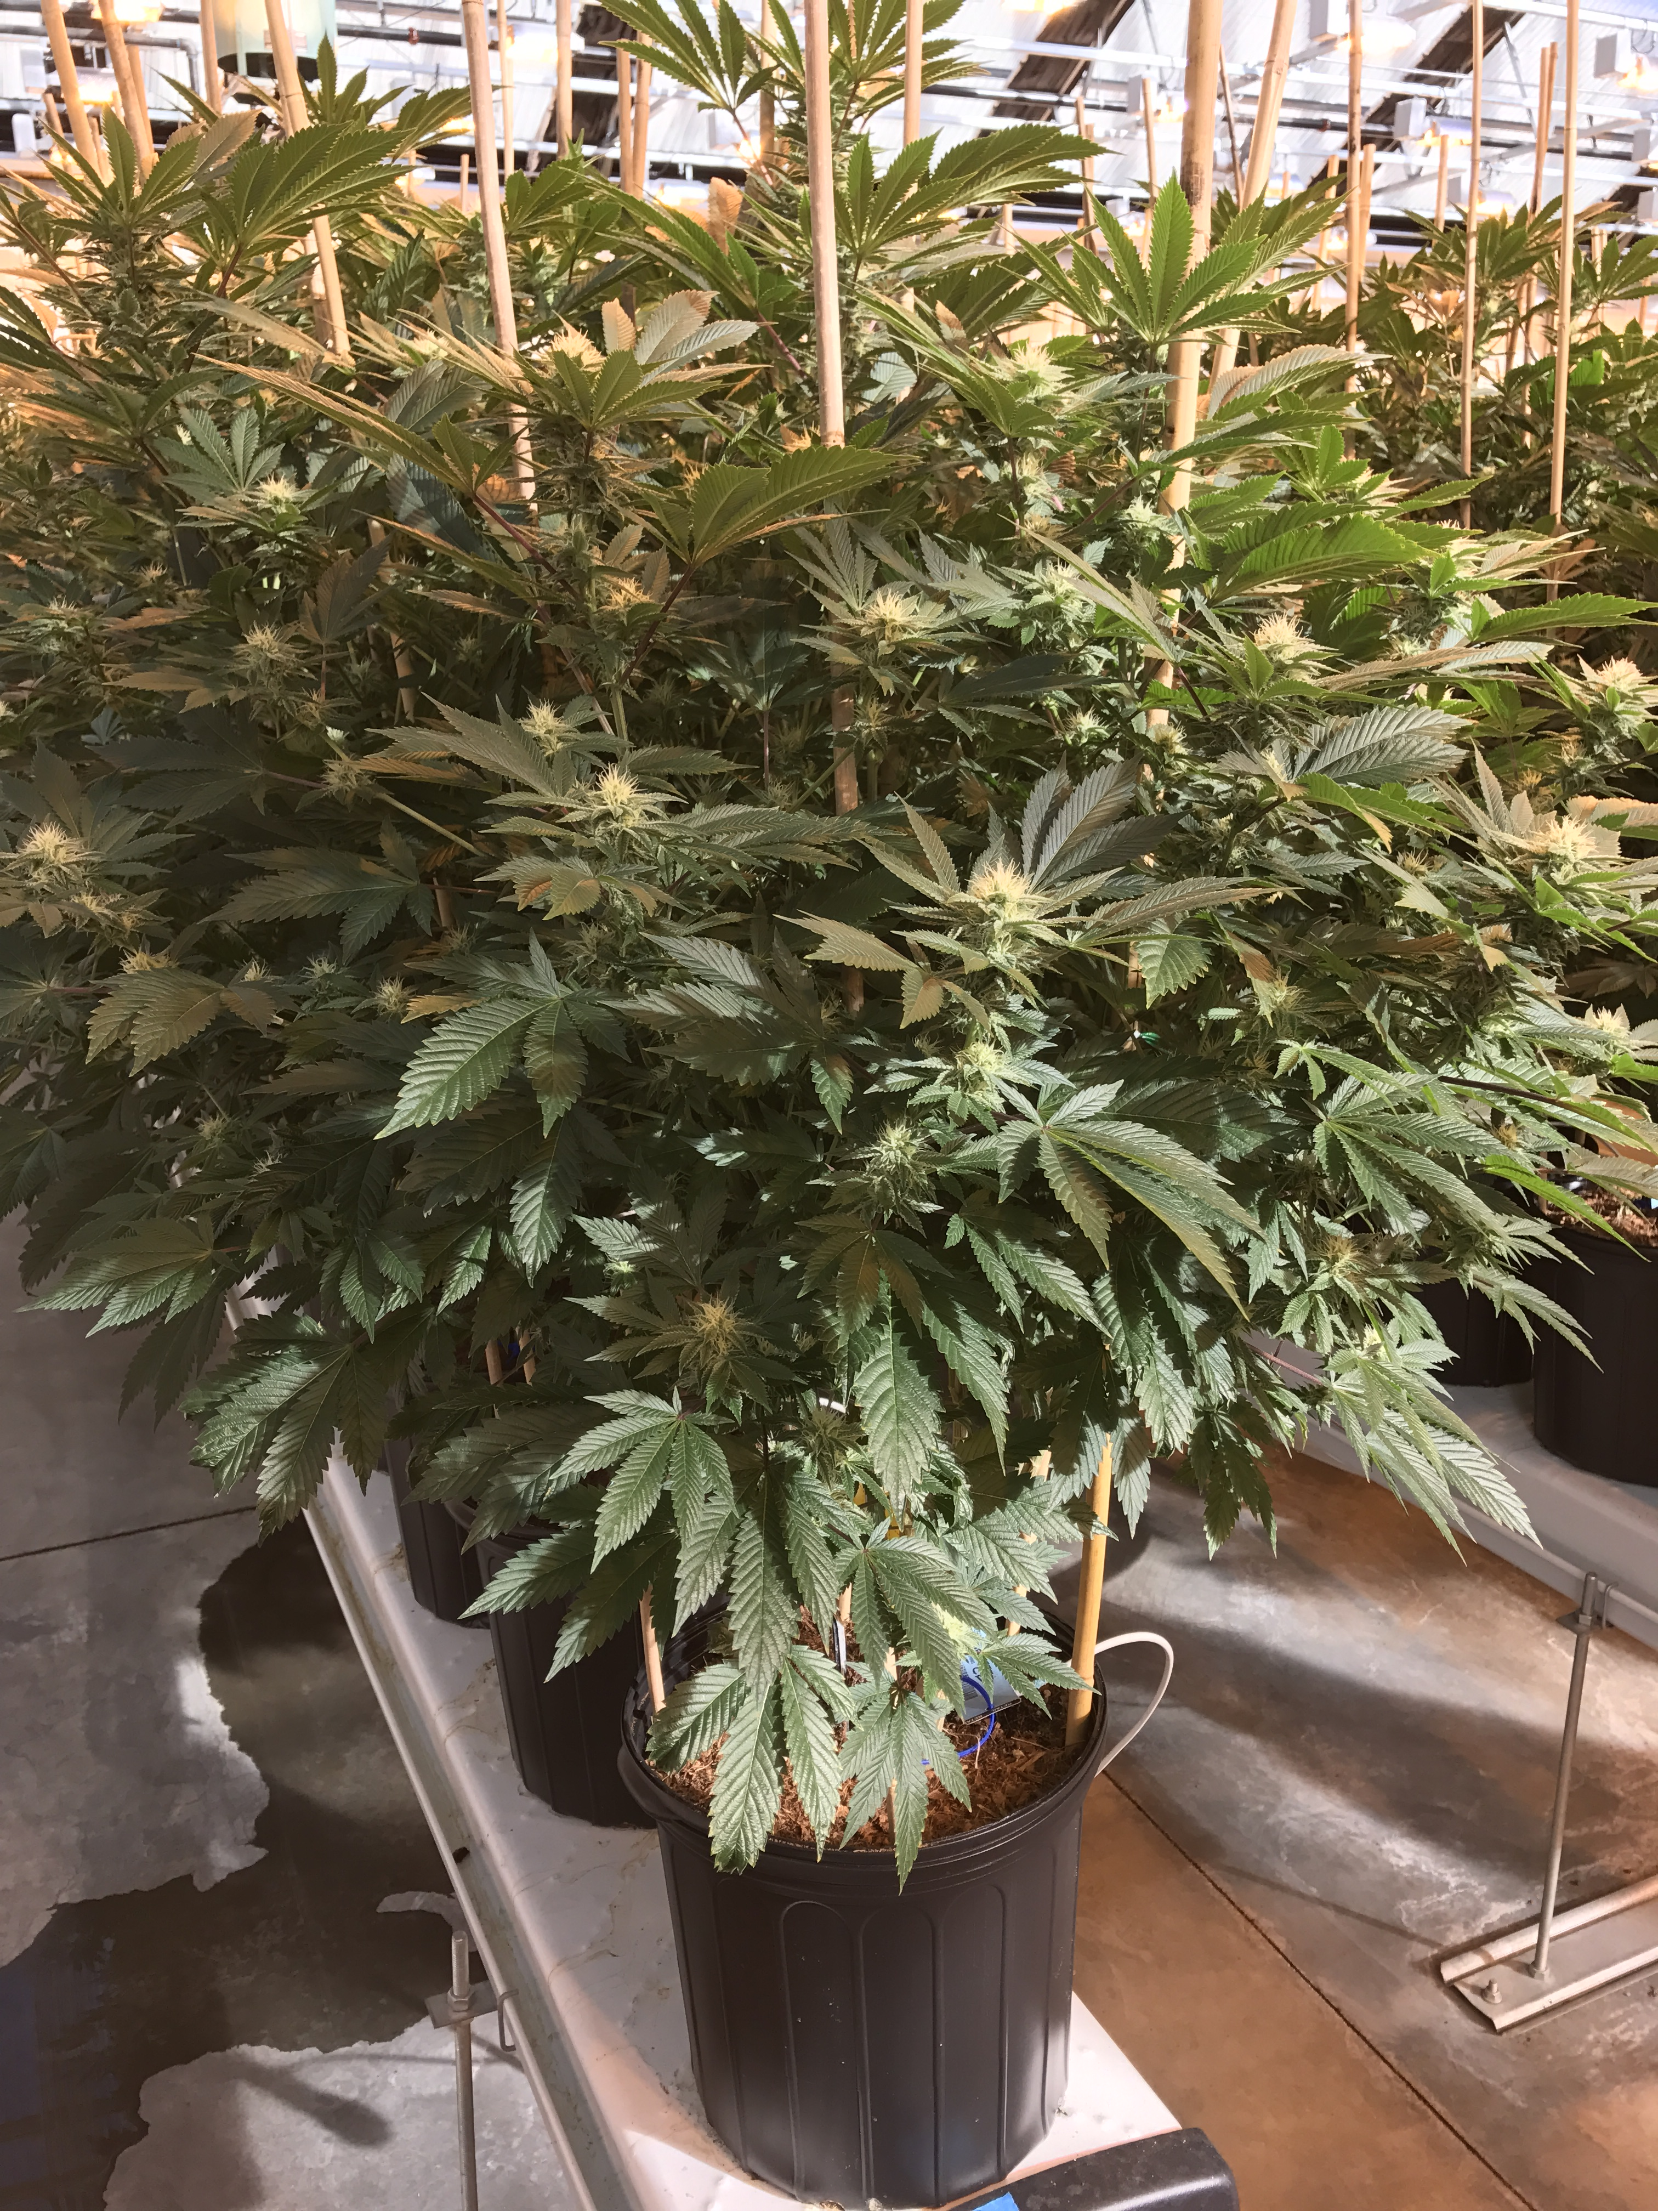
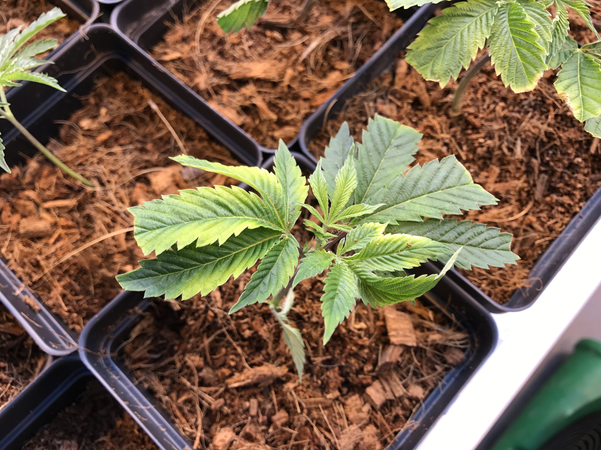
Riococo PCM 4.5kg Block
Growth Stage:
4.5kg /10 Lb PCM Block - Expand and fill containers
14.42 gallon approximate expansion per block
7.5 Gallons of water is needed to expand one block

Slide 8
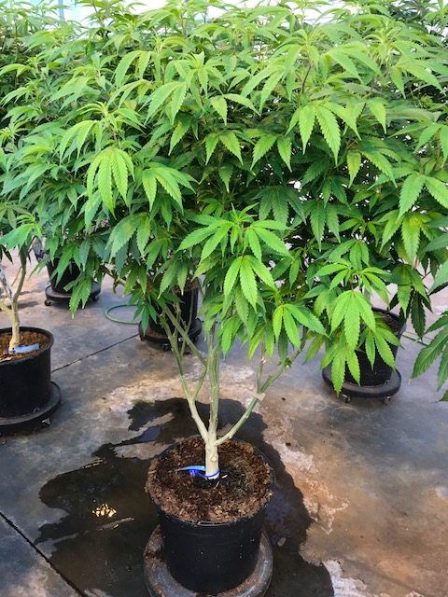
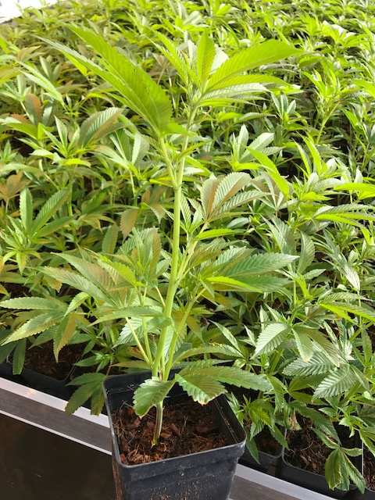
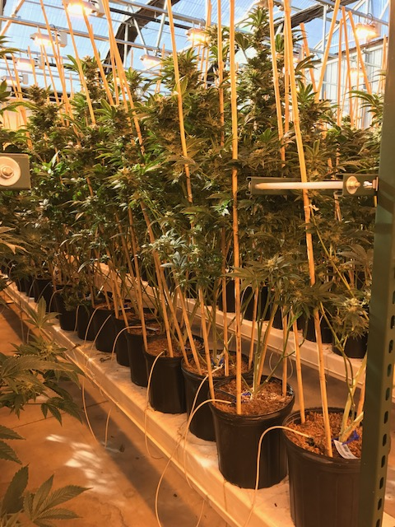
Greenhouse – Pots/Containers

Slide 9
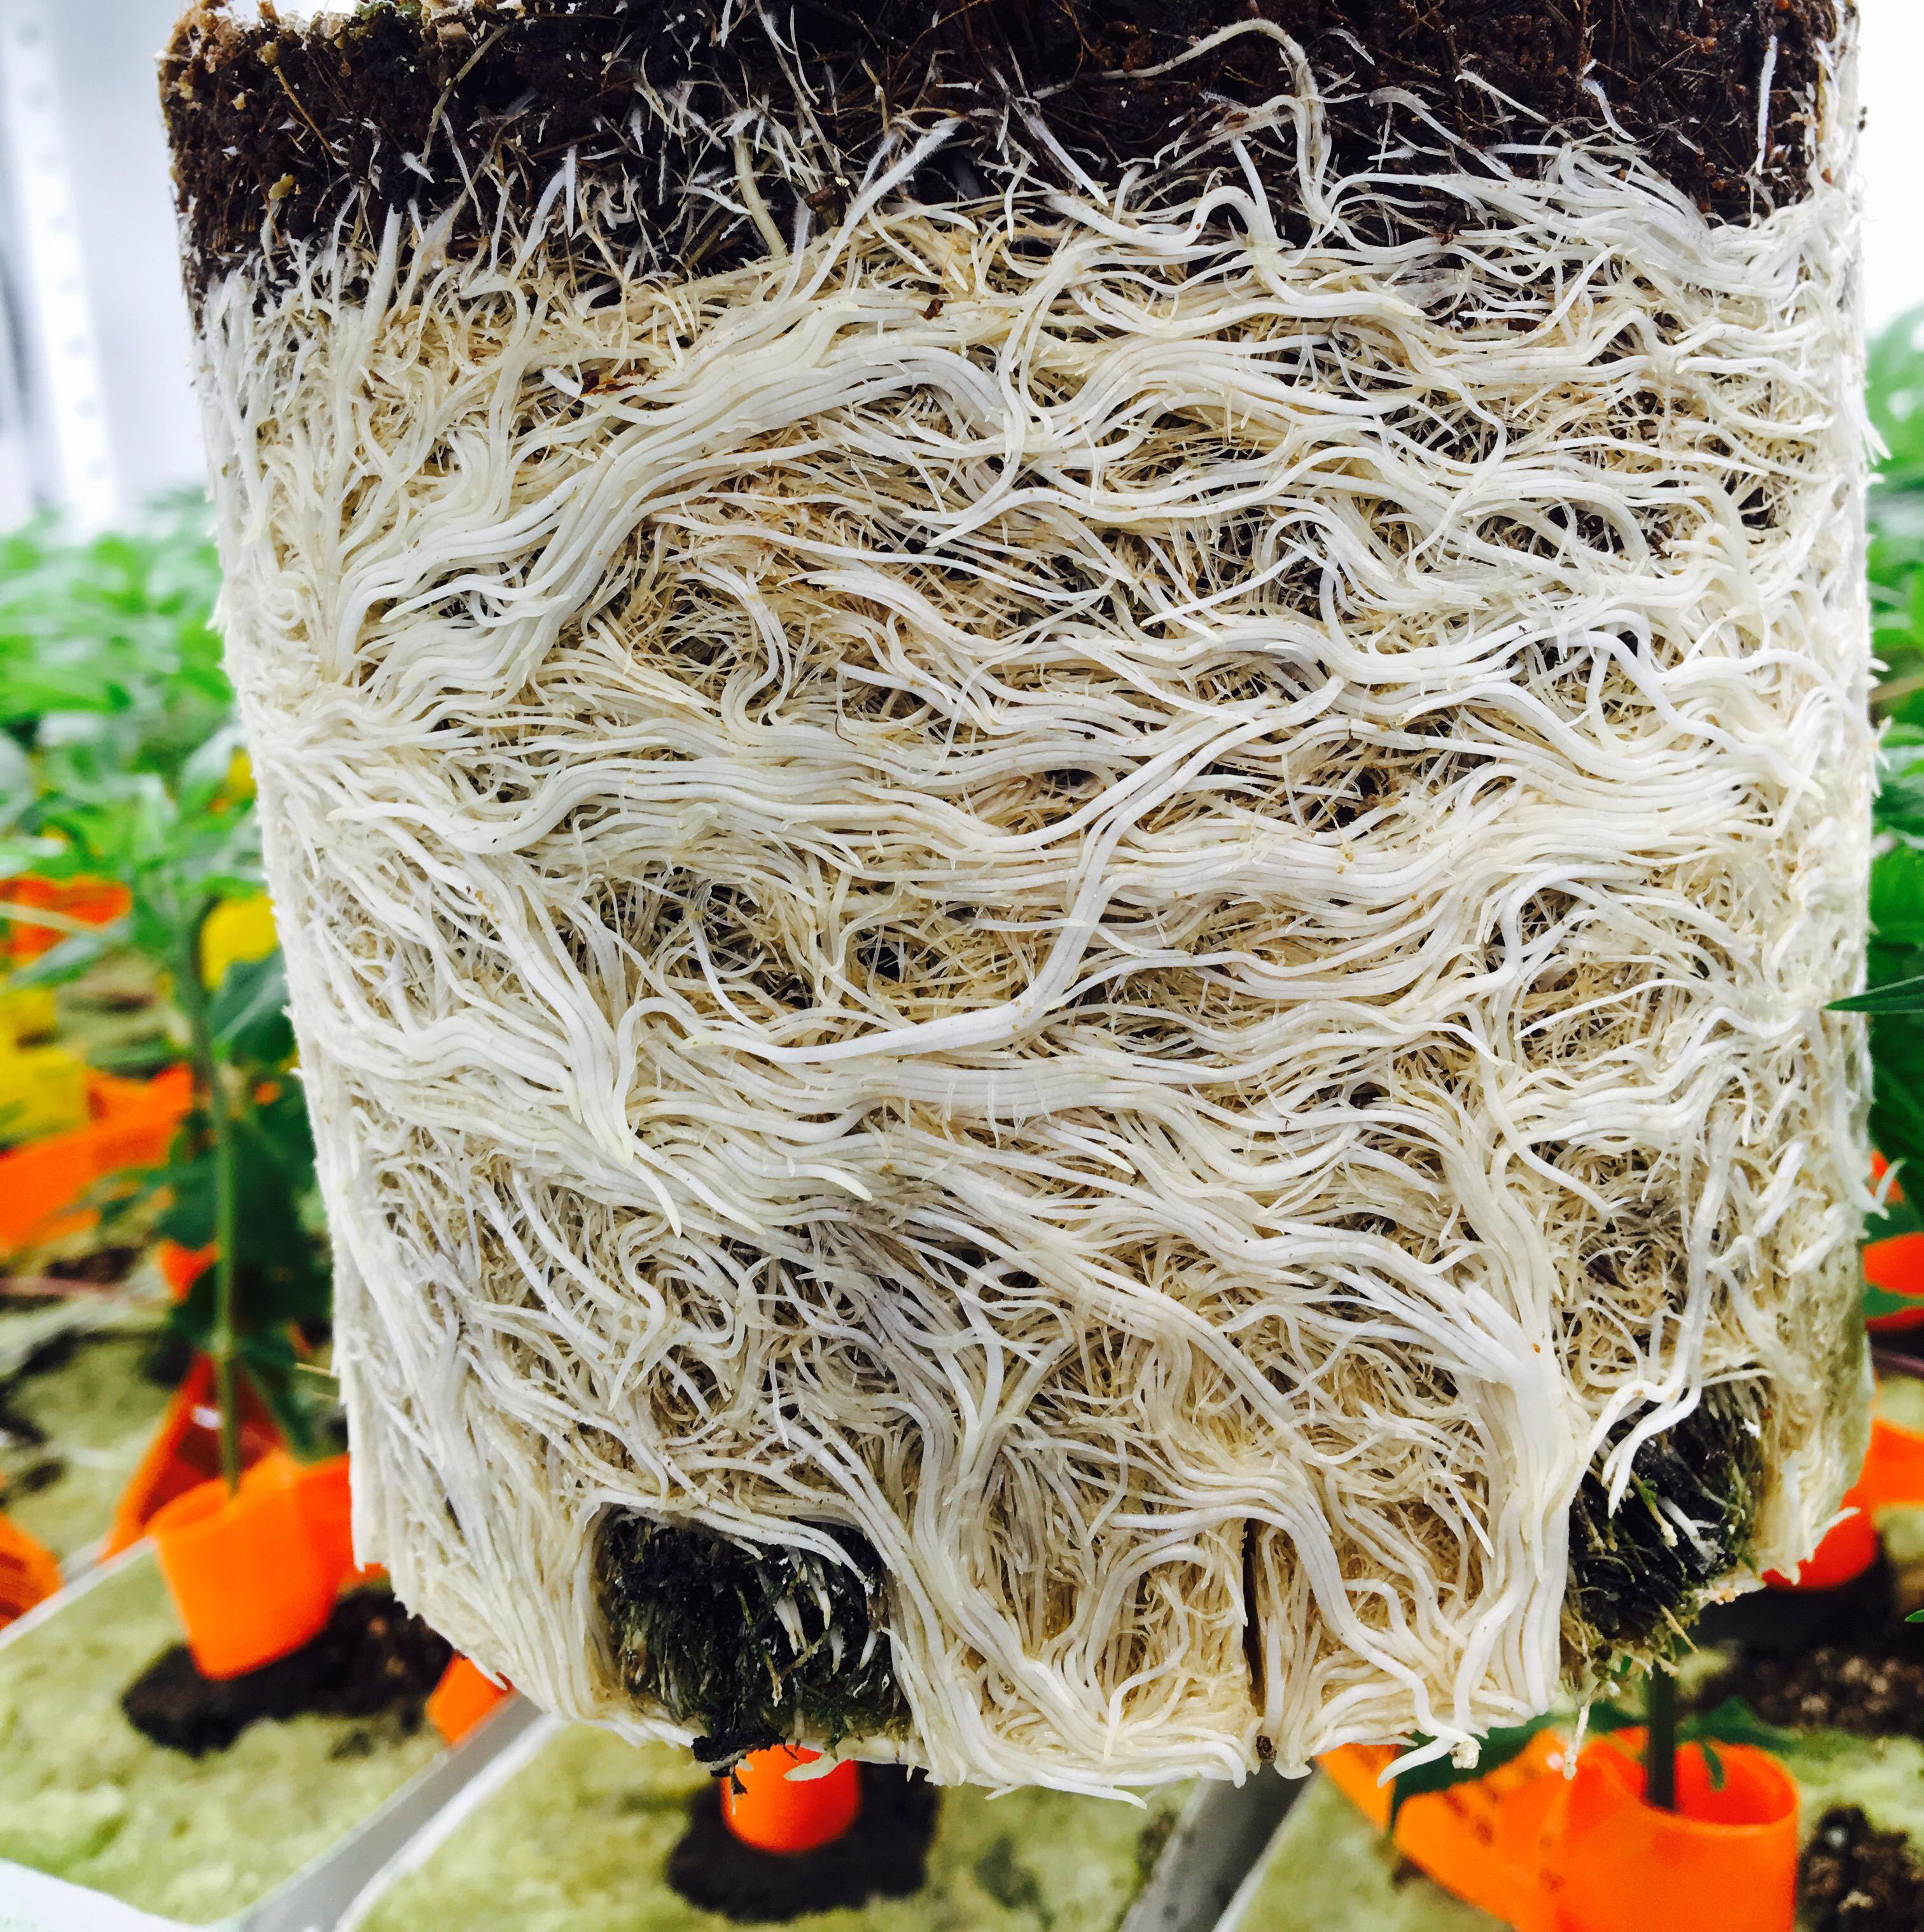
Amazing Roots in pots/containers

Slide 10
Riococo PCM OTBs
Growth Stage:
Open Top Bags (OTBs) – Indoor/Greenhouse growing, similar to containers without the mess
1, 2, 3 and 5 gallon available

Slide 11
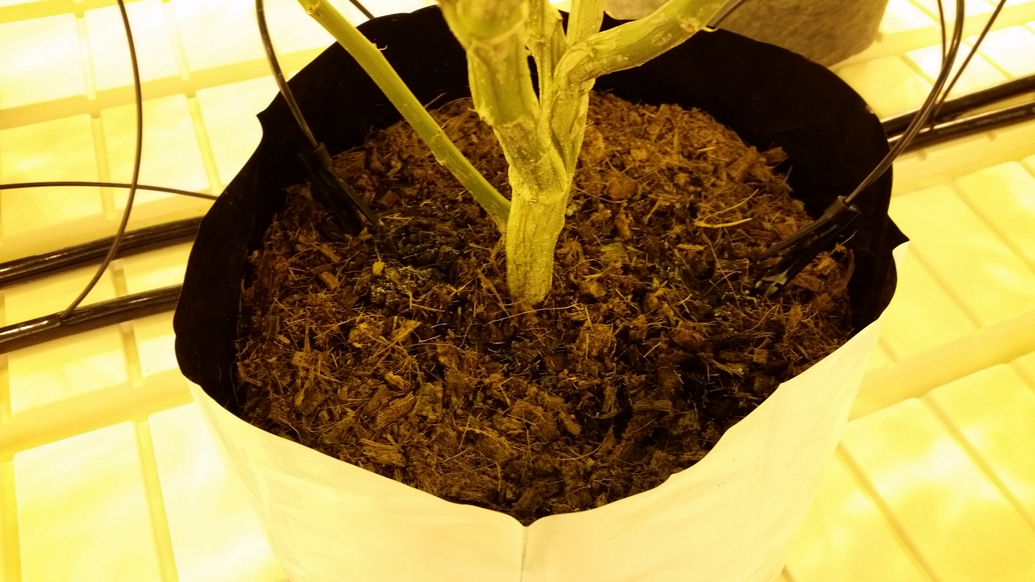
Greenhouse – Open Top Bags (OTBs)

Slide 12
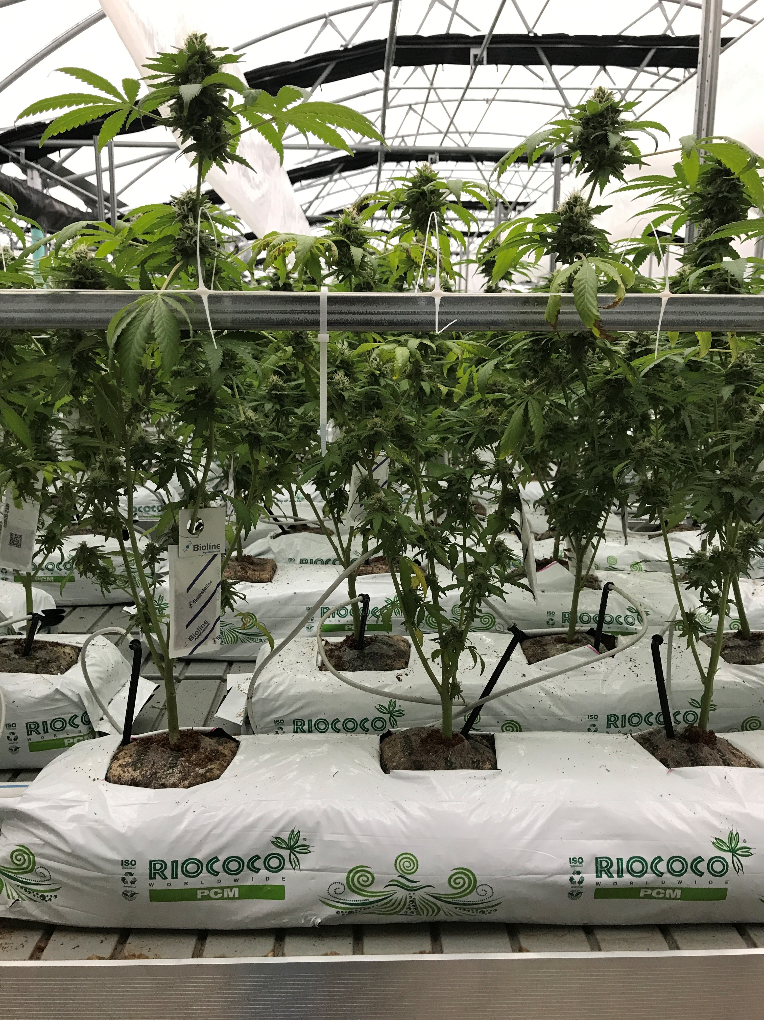
Riococo PCM Product Line
Growth Stage:
Grow Bags – For true Hydroponic Setups, or Sea of Green.

Slide 13
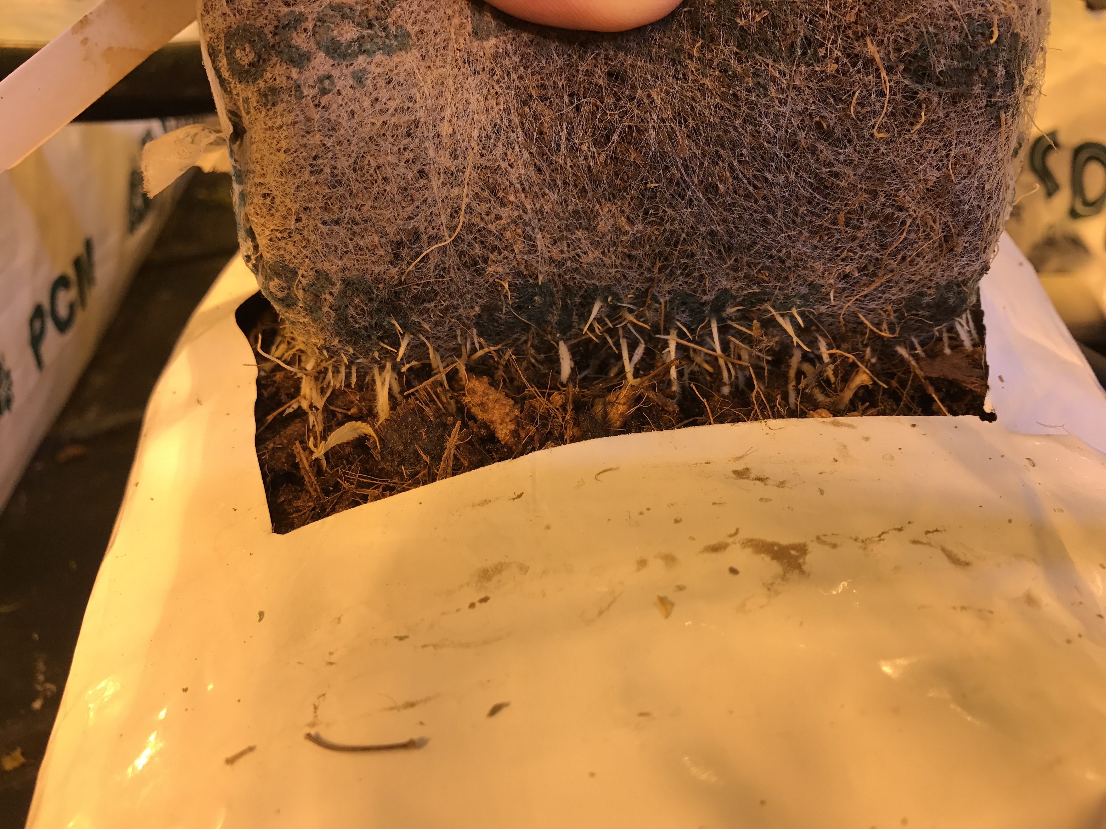
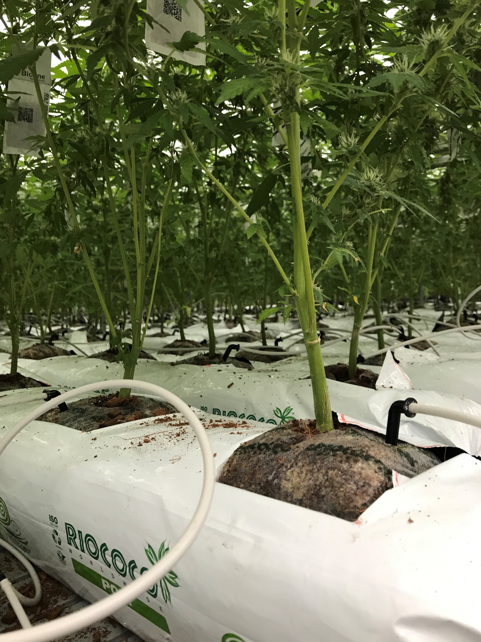
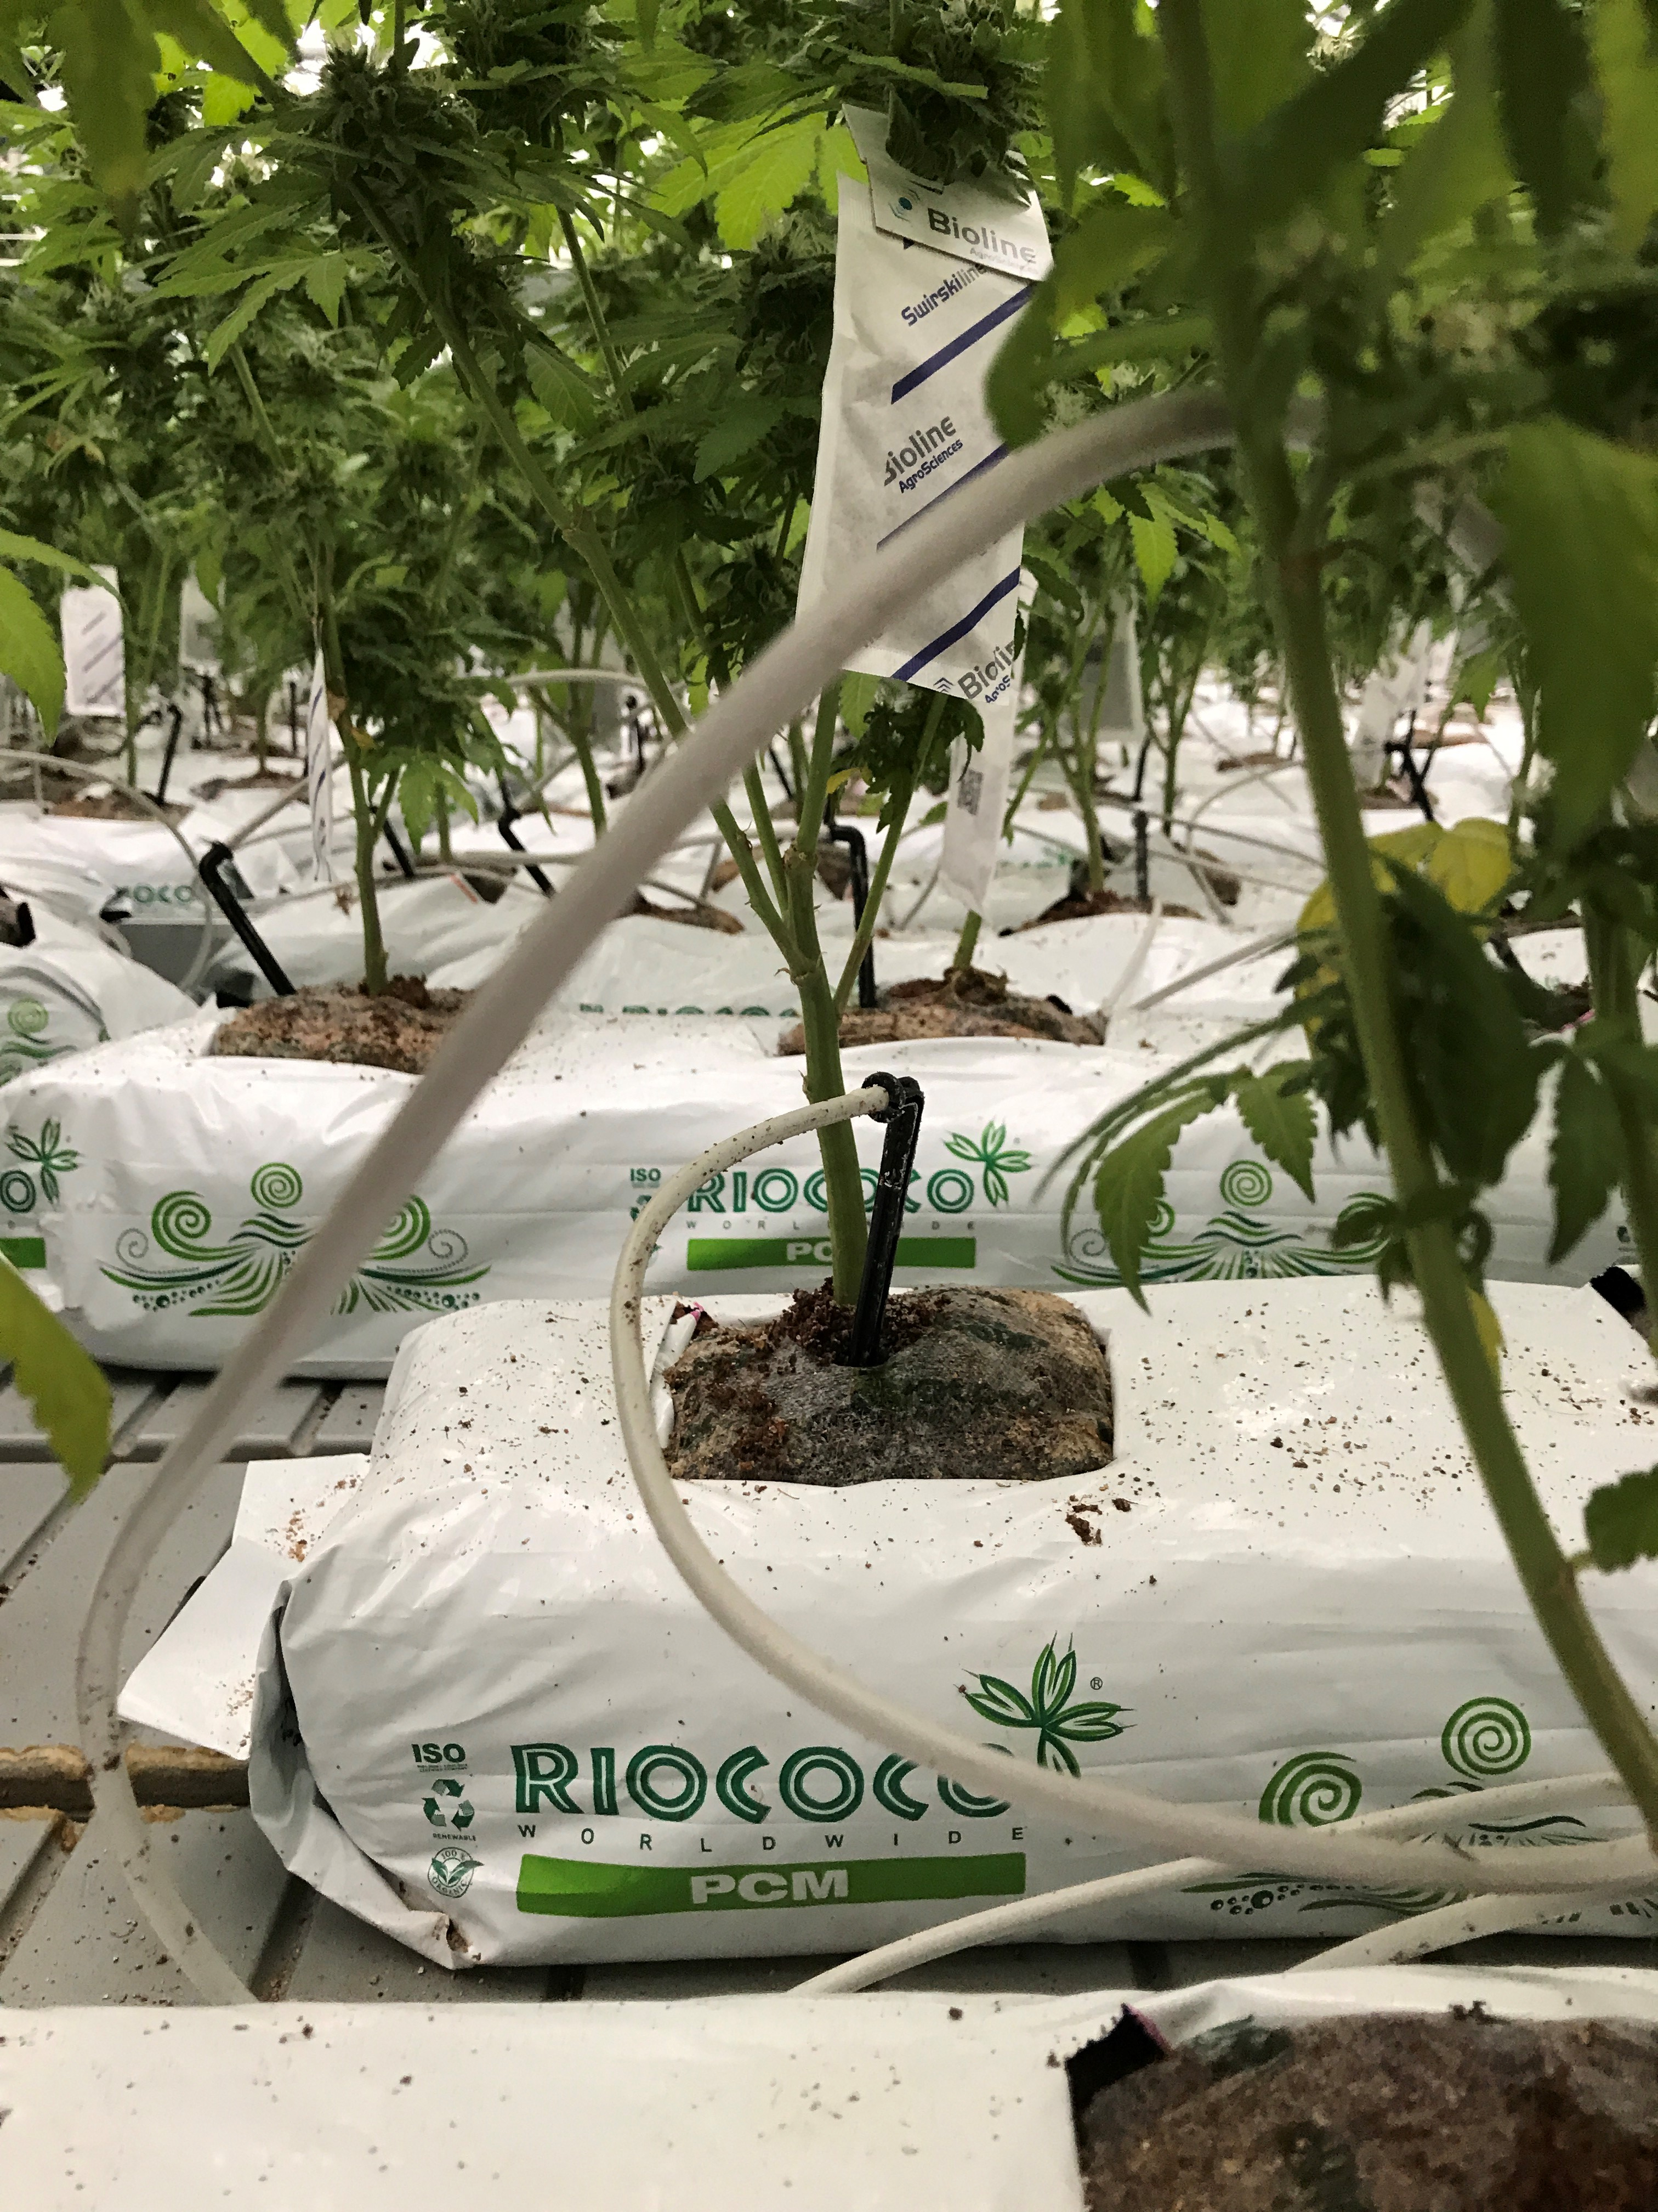
Sea of Green - Hydroponics

Slide 14
Riococo PCM CTBs
Growth Stage:
Close Top Bags (OTBs) – Indoor/Greenhouse growing, similar to containers without the mess
1 gallon bag is available

Slide 15
RIOCOCO PCM

